Slide 1
Logistic Regression

Slide 2

Classification and Representation
Classification
Example:
Email: Spam / Not Spam?
Online Transactions: Fraudulent (Yes/No)?
Tumor: Benign / Malignant?
Binary Classification
$h\left(x\right)→y, y ε \left\{0, 1\right\}$
0: Negative Class
1: Positive Class

Slide 3
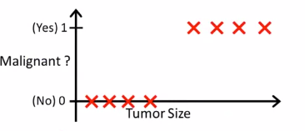
Classification and Representation
Classification
Solving classification as a regression problem

Slide 4
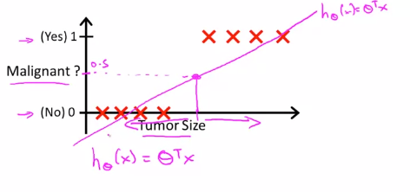
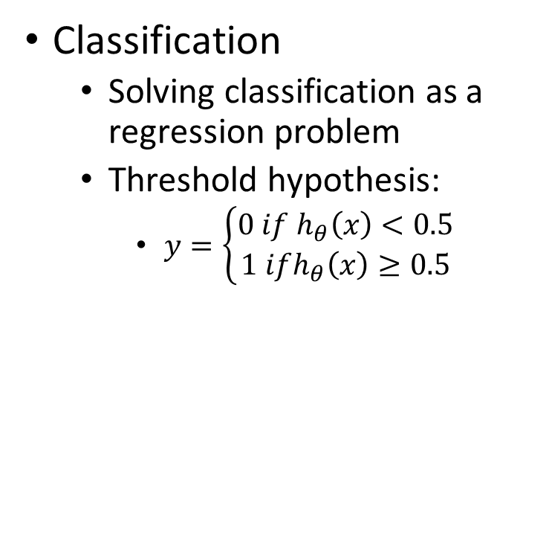
Classification and Representation
Classification
Solving classification as a regression problem
Threshold hypothesis:
$y=\left\{\begin{aligned}0 if h_{θ}\left(x\right)<0.5 \\ 1 ifh_{θ}\left(x\right)≥0.5\end{aligned}\right.$

Slide 5
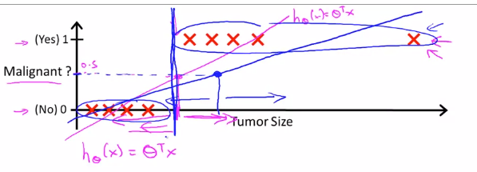
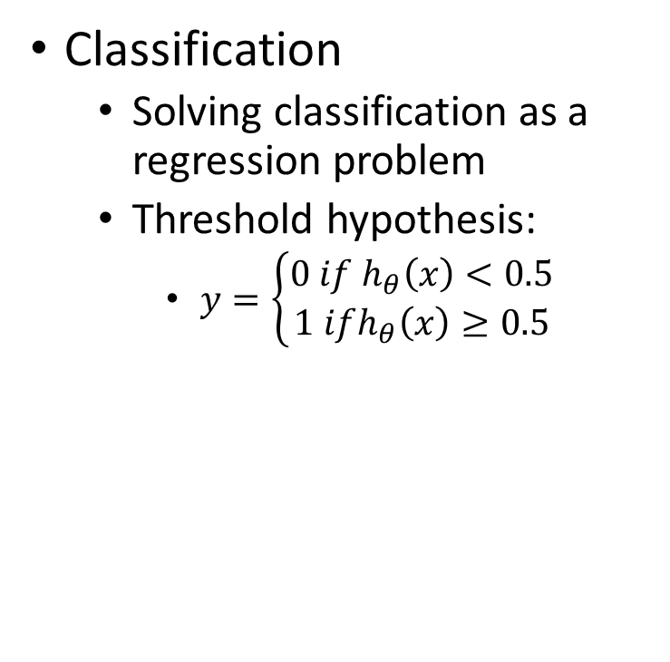
Classification and Representation
Classification
Solving classification as a regression problem
Threshold hypothesis:
$y=\left\{\begin{aligned}0 if h_{θ}\left(x\right)<0.5 \\ 1 ifh_{θ}\left(x\right)≥0.5\end{aligned}\right.$

Slide 6

Classification and Representation
Classification
$y ε \left\{0, 1\right\}$
Hypothesis value range: $h_{θ}\left(x\right) ∈R$
Logistic Regression: $0≤h_{θ}\left(x\right)≤1$

Slide 7
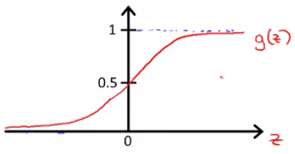

Classification and Representation
Hypothesis Representation
Logistic Regression Model
$0≤h_{θ}\left(x\right)≤1$
$h_{θ}\left(x\right)=g(θ^{T}x)$
$g\left(z\right)= \frac{1}{1+e^{−z}}$
$h_{θ}\left(x\right)=\frac{1}{1+e^{−θ^{T}x}}$
$0≤h_{θ}\left(x\right)<1$

Slide 8

Classification and Representation
Hypothesis Representation
$h_{θ}\left(x\right)$ = estimated probability that y = 1, given input x
$h_{θ}\left(x\right)=P\left(y=1\right|x, θ)$
$P\left(y=1\right|x, θ)+P\left(y=0\right|x, θ)=1$

Slide 9
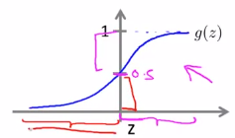

Classification and Representation
Decision Boundary
Boundary = 0.5
$y=\left\{\begin{aligned}0 if h_{θ}\left(x\right)<0.5 \\ 1 ifh_{θ}\left(x\right)≥0.5\end{aligned}\right.$
$y=\left\{\begin{aligned}0 ifθ^{T}x<0 \\ 1 ifθ^{T}x≥0\end{aligned}\right.$

Slide 10
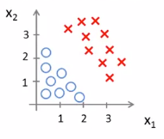

Classification and Representation
Decision Boundary
$h_{θ}\left(x\right)=g(θ_{0}+ θ_{1}x_{1}+θ_{2}x_{2})$
$θ=\begin{matrix}−3 \\ 1 \\ 1\end{matrix}$
$y=1 if −3+x_{1}+x_{2}≥0$

Slide 11

Classification and Representation
Decision Boundary
$h_{θ}\left(x\right)=g(θ_{0}+ θ_{1}x_{1}+θ_{2}x_{2})$
$θ=\left[\begin{matrix}−3 \\ 1 \\ 1\end{matrix}\right]$
$y=1 if −3+x_{1}+x_{2}≥0$

Slide 12
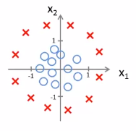
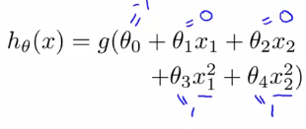

Classification and Representation
Non-linear Decision Boundary
$y=1 if −1+x_{1}^{2}+x_{2}^{2}≥0$

Slide 13
Classification and Representation
Non-linear Decision Boundary
$y=1 if −1+x_{1}^{2}+x_{2}^{2}≥0$

Slide 14
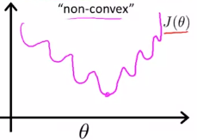
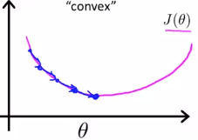

Logistic Regression Model
Cost function
Logistic model:
$h_{θ}\left(x\right)=\frac{1}{1+e^{−θ^{T}x}}$
Mean Square Error
What we want

Slide 15

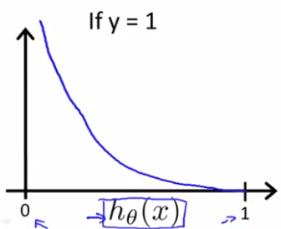

Logistic Regression Model
Cost function
$Cost=0 if y=1, h_{θ}\left(x\right)=1$
$Cost → +∞ ifh_{θ}\left(x\right)→0$

Slide 16
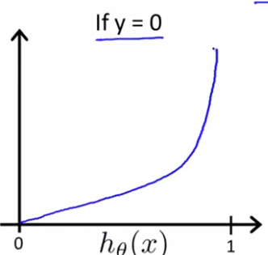

Logistic Regression Model
Cost function
$Cost=0 if y=0, h_{θ}\left(x\right)=0$
$Cost → +∞ ifh_{θ}\left(x\right)→1$

Slide 17

Logistic Regression Model
Simplified Cost Function
$y ∈\{0, 1\}$
$Cost\left(h_{θ}\left(x\right), y\right)= −ylog\left(h_{θ}\left(x\right)\right) −\left(1 −y\right)log⁡(1 −h_{θ}\left(x\right))$

Slide 18
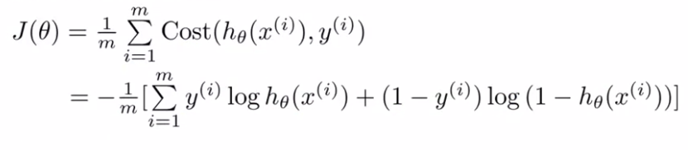

Logistic Regression Model
Simplified Cost Function
Gradient
$\frac{∂}{∂θ_{j}}J\left(θ\right)= \frac{1}{m} \sum_{i=1}^{m}{\left(h_{θ}\left(x^{\left(i\right)}\right)−y^{\left(i\right)}\right)x_{j}^{(i)}}$

Slide 19

Logistic Regression Model
Advanced Optimization
Gradient Descent
Conjugate gradient
BFGS
L-BFGS
Advantages:
No need to choose $α$
Faster than gradient descent
Disadvantages:
More complex

Slide 20
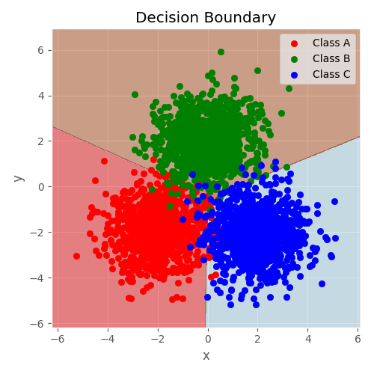
Multiclass classification
More than 2 classes

Slide 21
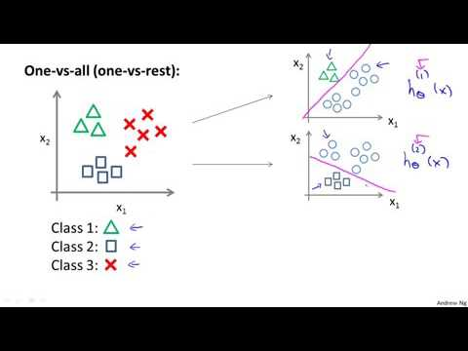
One vs all
Main class is Positive class, other classes
are negative class

Slide 22
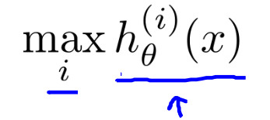
One vs all
On a new input , to make a predicton, pick the class that maximizes

Slide 23
The problem of overfitting

Slide 24
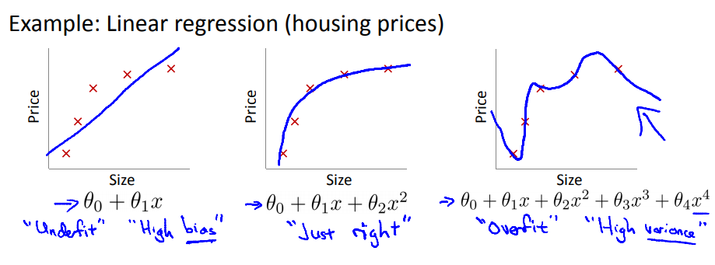
WHAT IS OVERFITTING ?
Overfitting: If we have too many features, the learned hypothesis may fit all the training set => J(θ) ≈ 0 but fail to predict on new examples

Slide 25
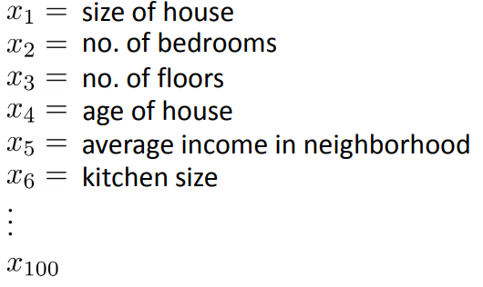
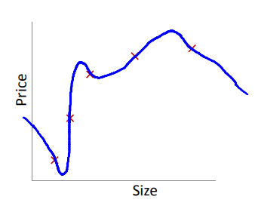
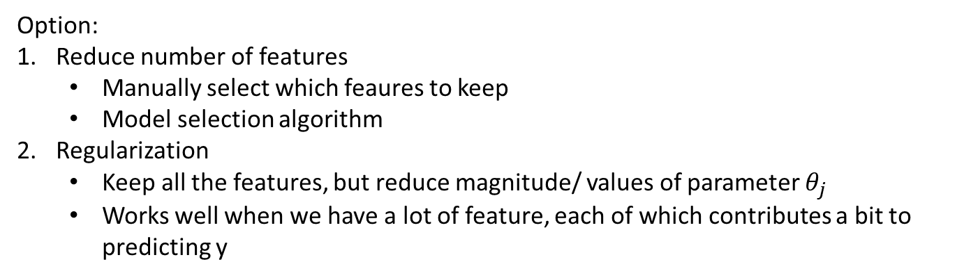
ADDRESSING OVERFITTING
Option:
Reduce number of features
Manually select which feaures to keep
Model selection algorithm
Regularization
Keep all the features, but reduce magnitude/ values of parameter $θ_{j}$
Works well when we have a lot of feature, each of which contributes a bit to predicting y

Slide 26
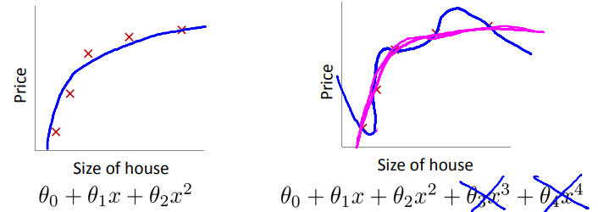
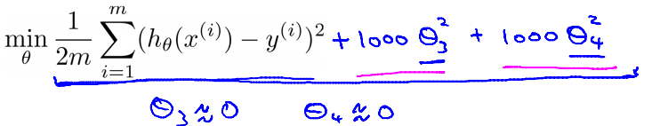
COST FUNCTION
Suppose we penalize and make $θ_{3},θ_{4}$really small

Slide 27
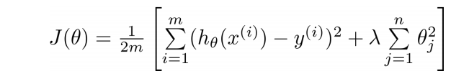
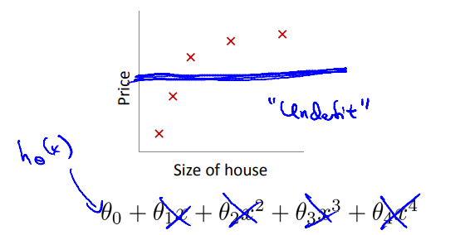
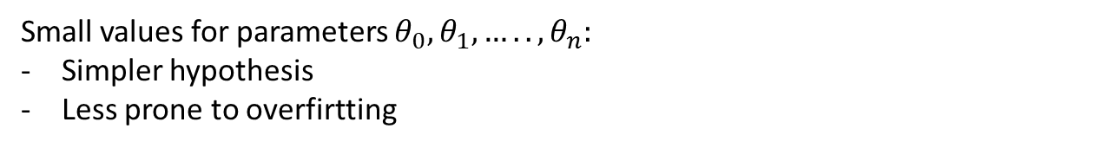
Small values for parameters $θ_{0},θ_{1},…..,θ_{n}:$
Simpler hypothesis
Less prone to overfirtting
Too big
Fails to eliminate overfitting
Gradienr descent will fail to converge

Slide 28
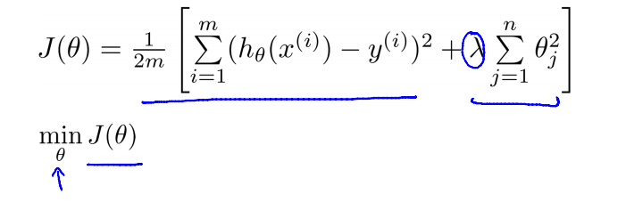
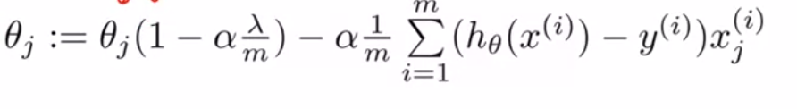
Regularized linear regression
Gradient descent

Slide 29
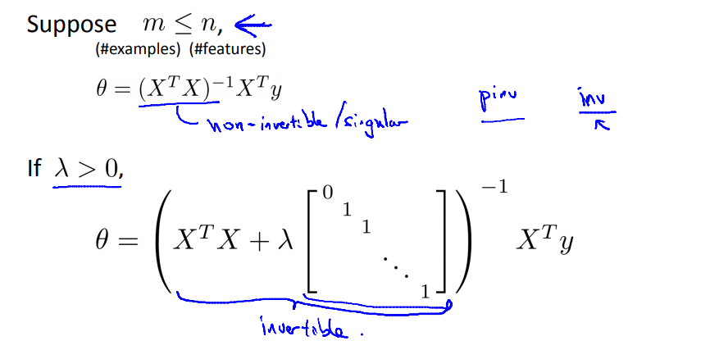
Normal equation

Slide 30
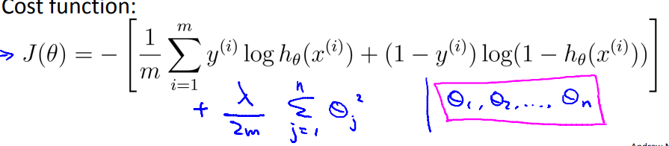
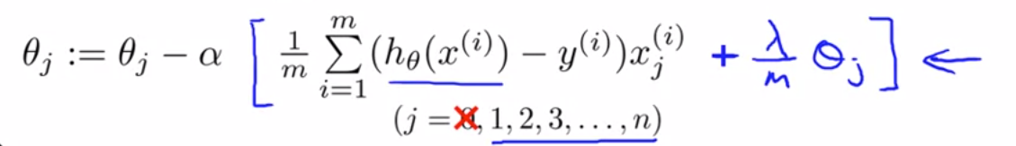
Regularized logistic regression
Gradient descent

Slide 31
Normal equation

